Slide 1
NOTE-BRIDGE 1
SPRINT REVIEW #1
PROTOTYPE & STORY MAP

Slide 2

Home page - sectıon 1

Slide 3

Home page - sectıon 1

Slide 4
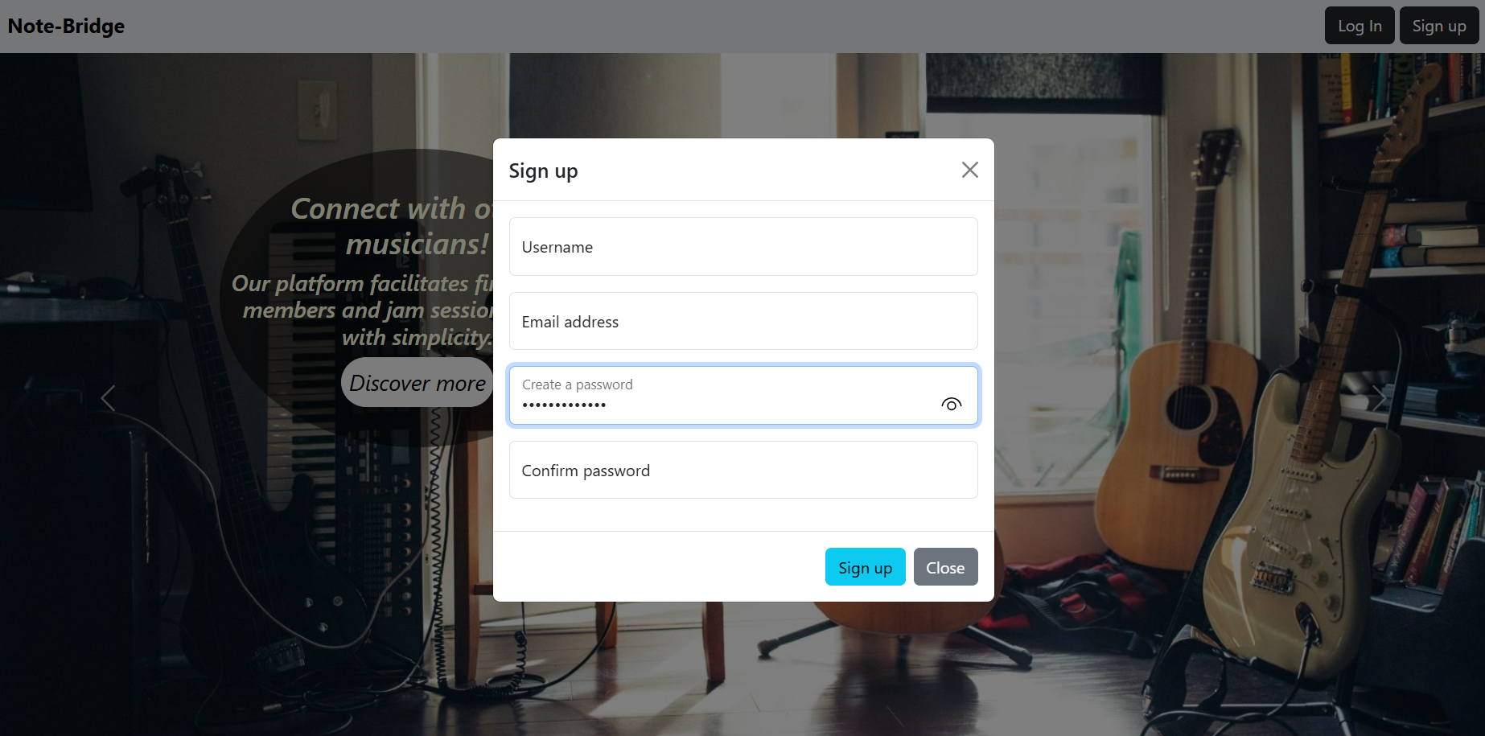
SIGN UP

Slide 5
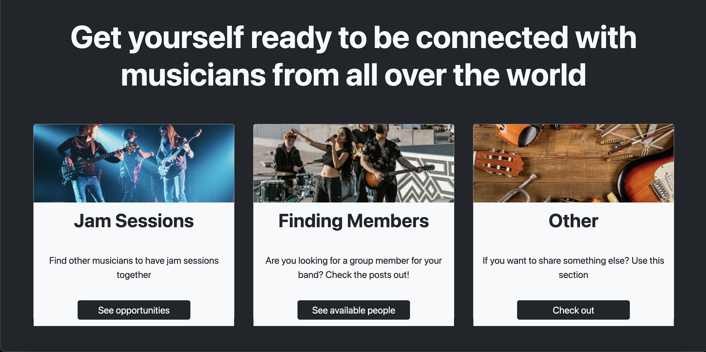
Home page - sectıon 2

Slide 6
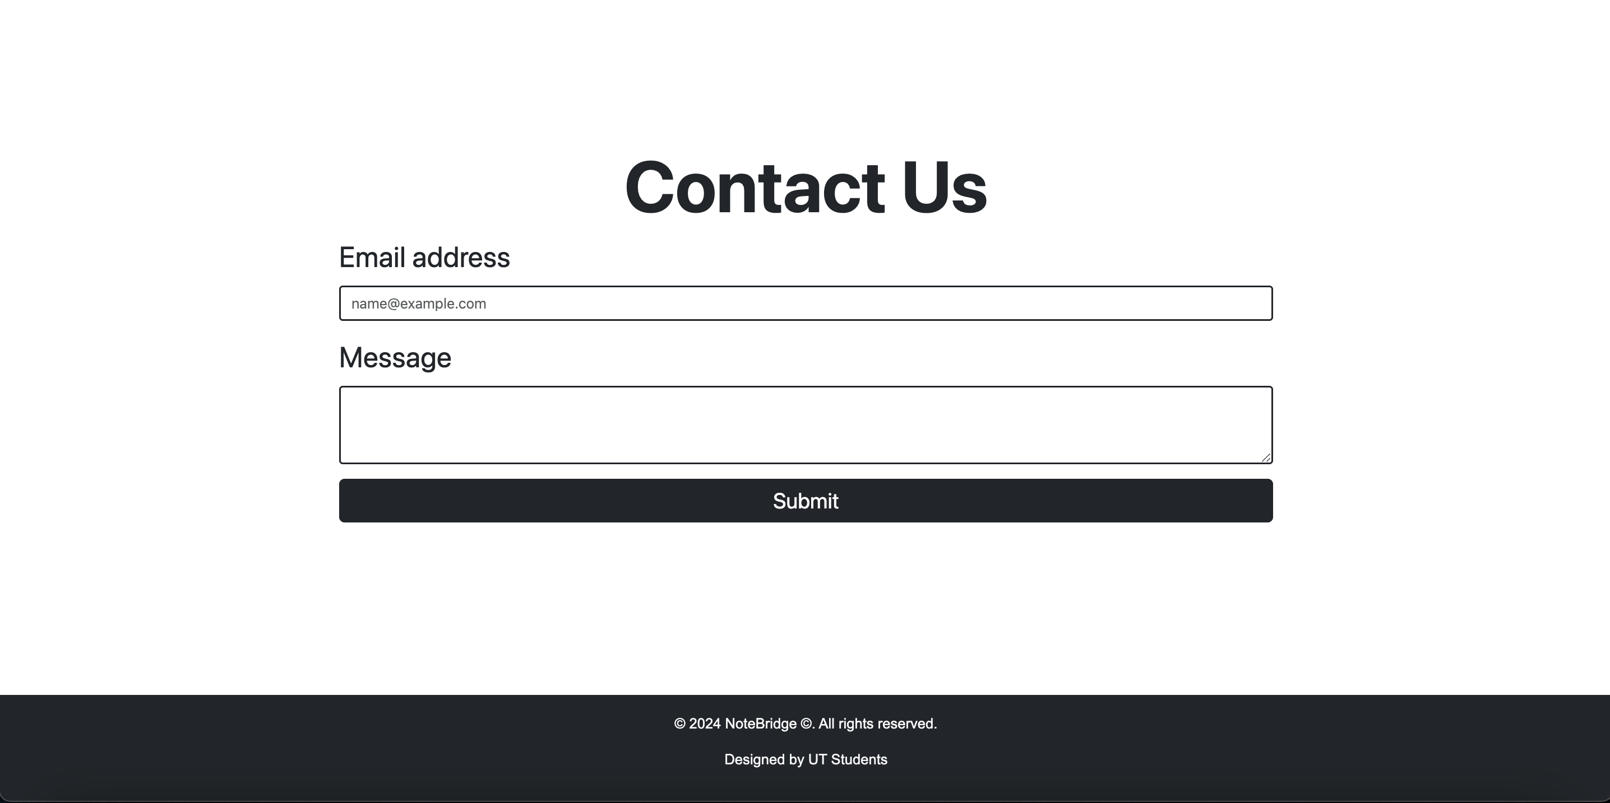
Home page - sectıon 3

Slide 7
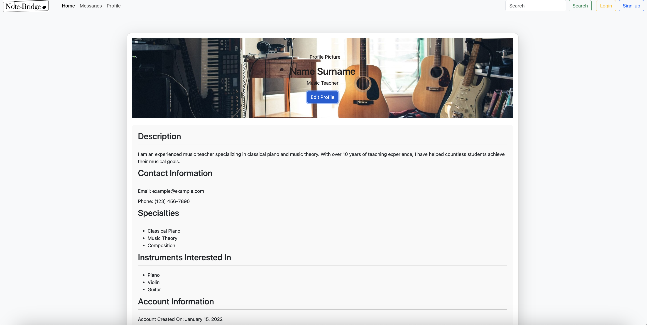
User profıle page

Slide 8
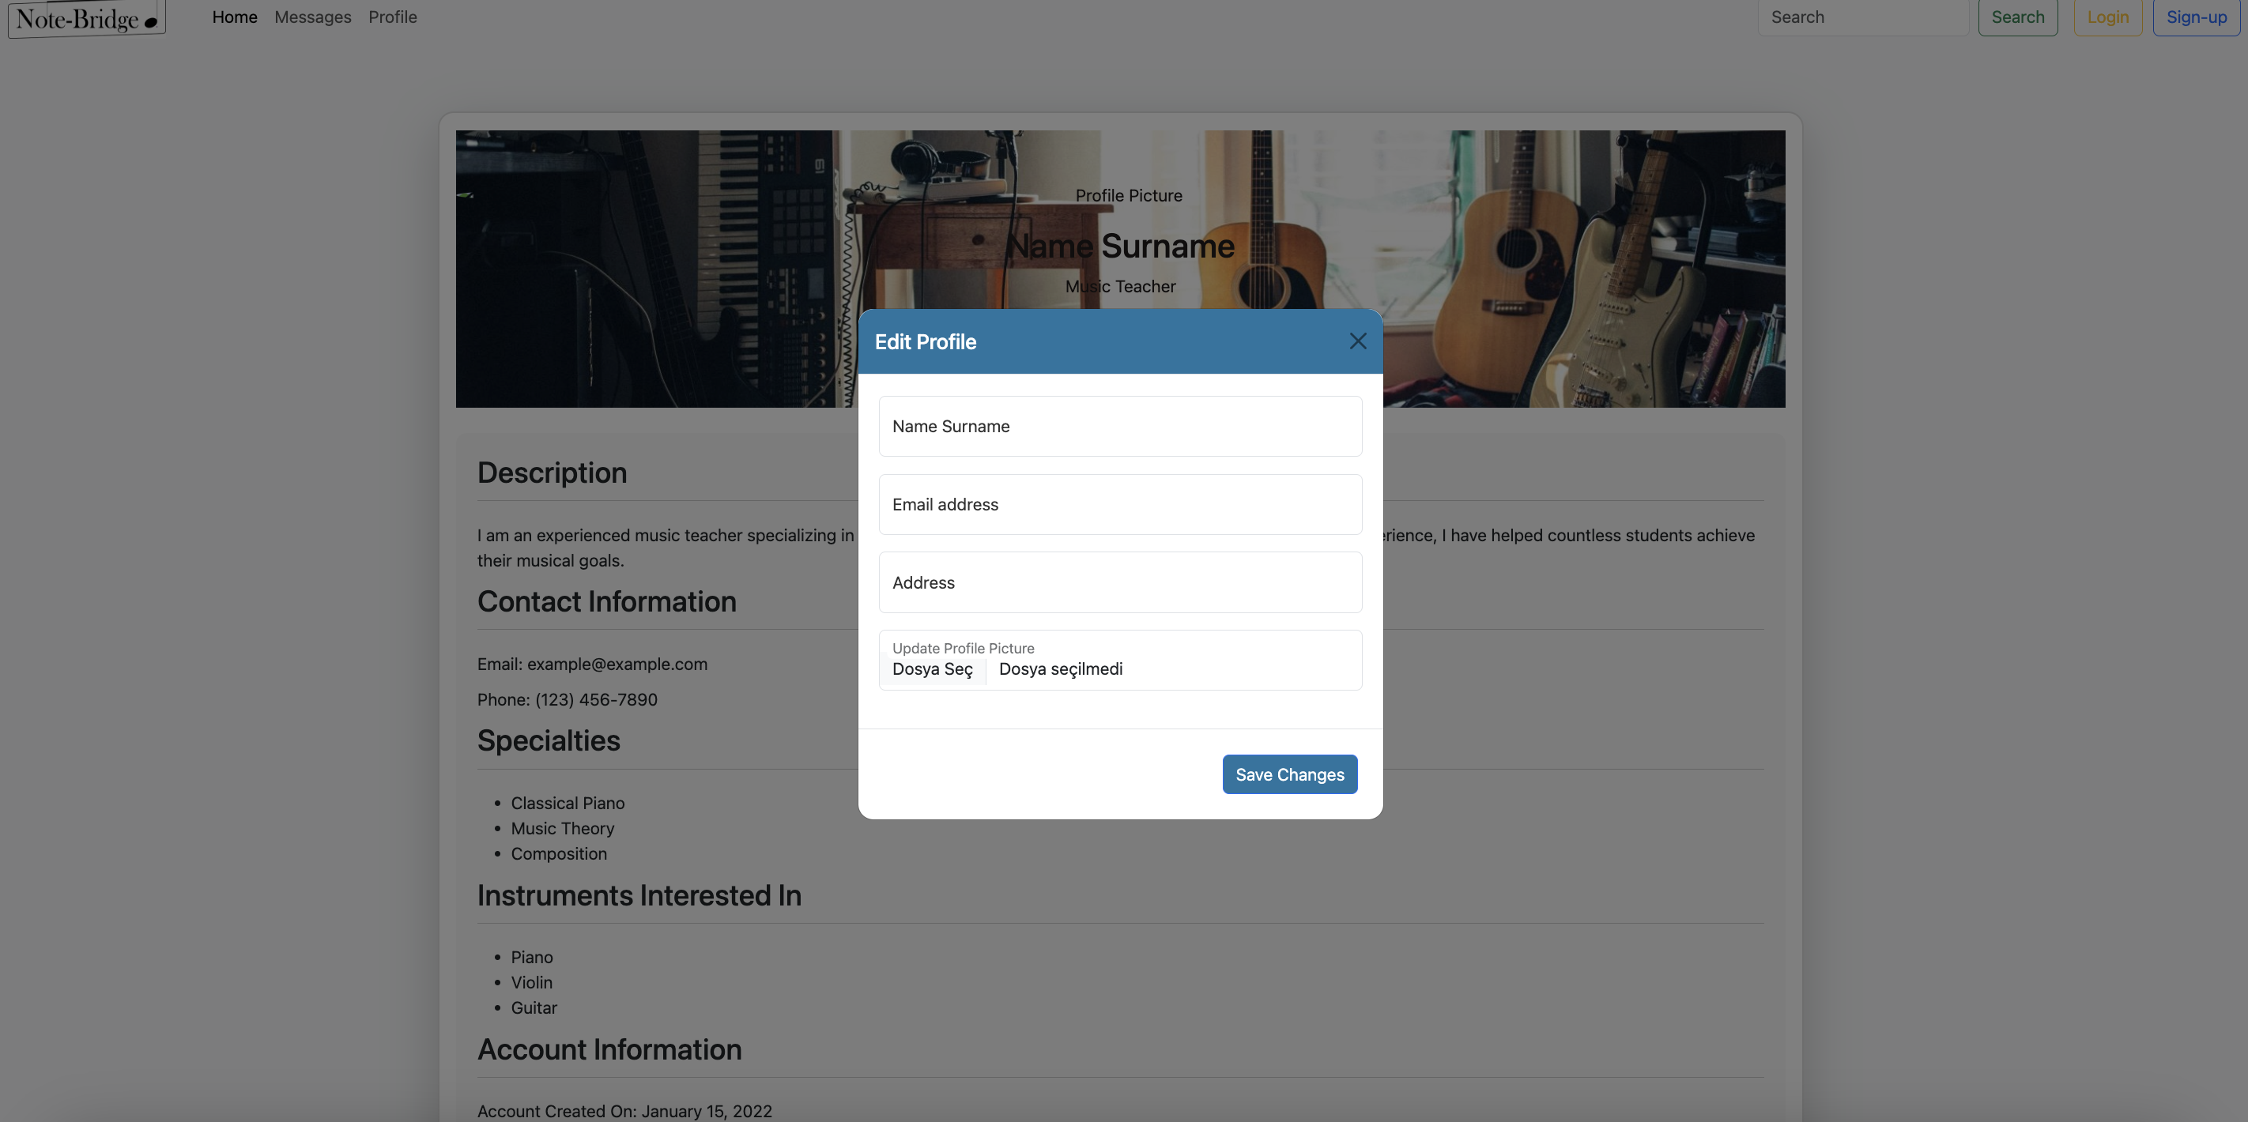
User profıle edıt page

Slide 9
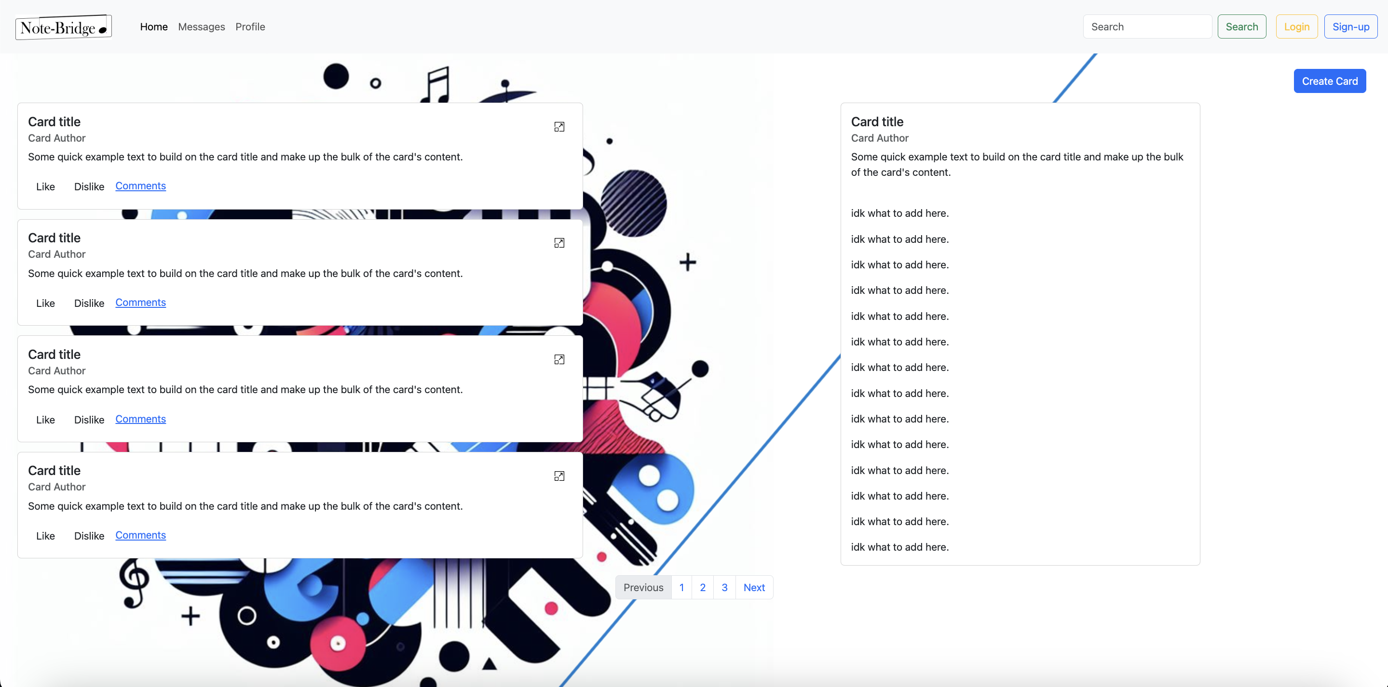
Cards overvıew page

Slide 10
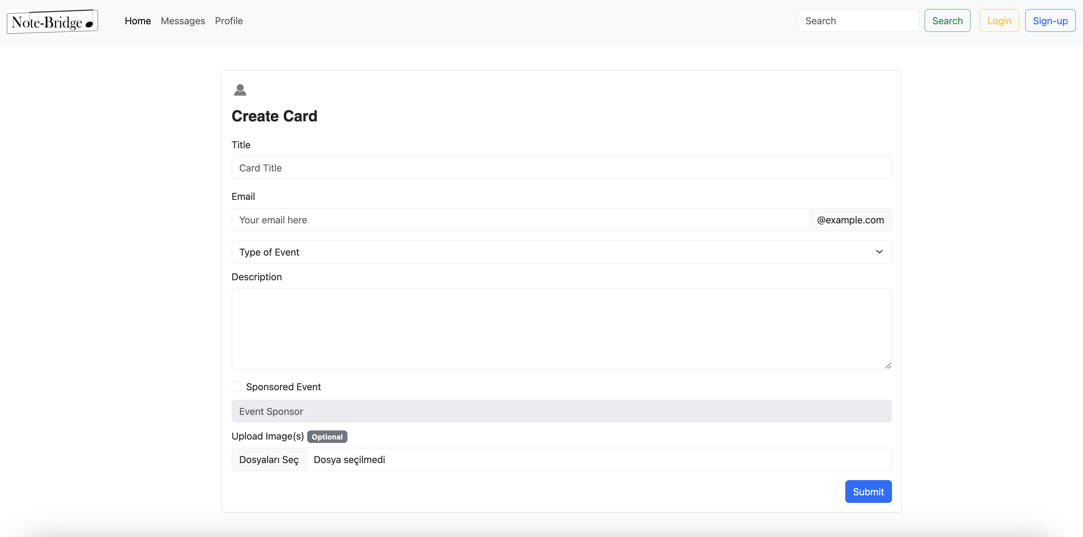
Create card page

Slide 11
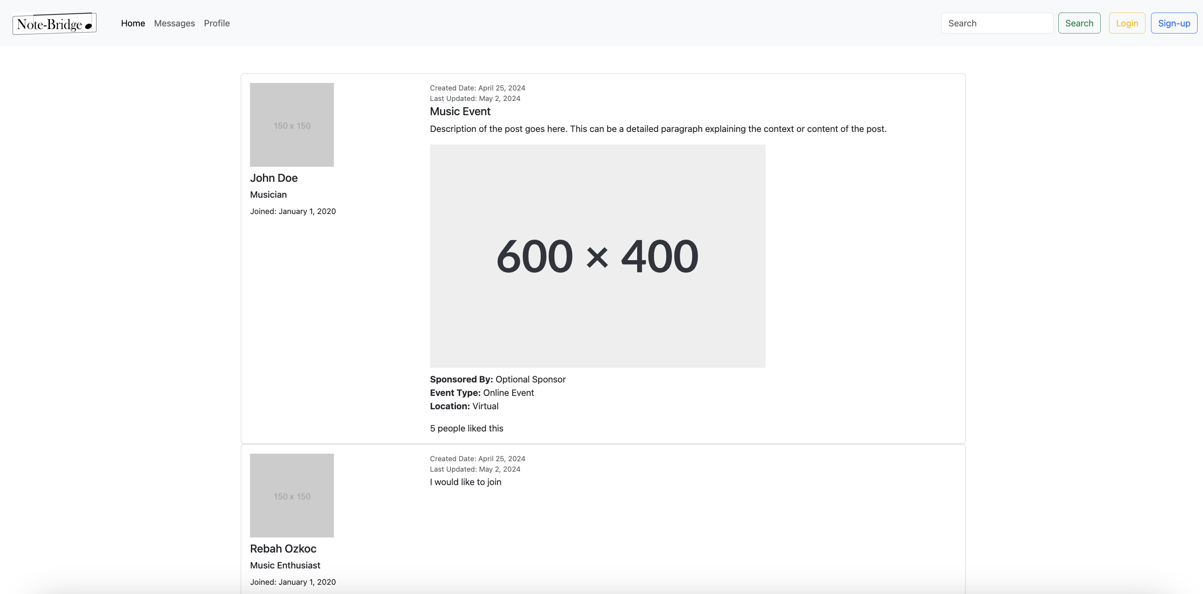
Detaıled card page

Slide 12
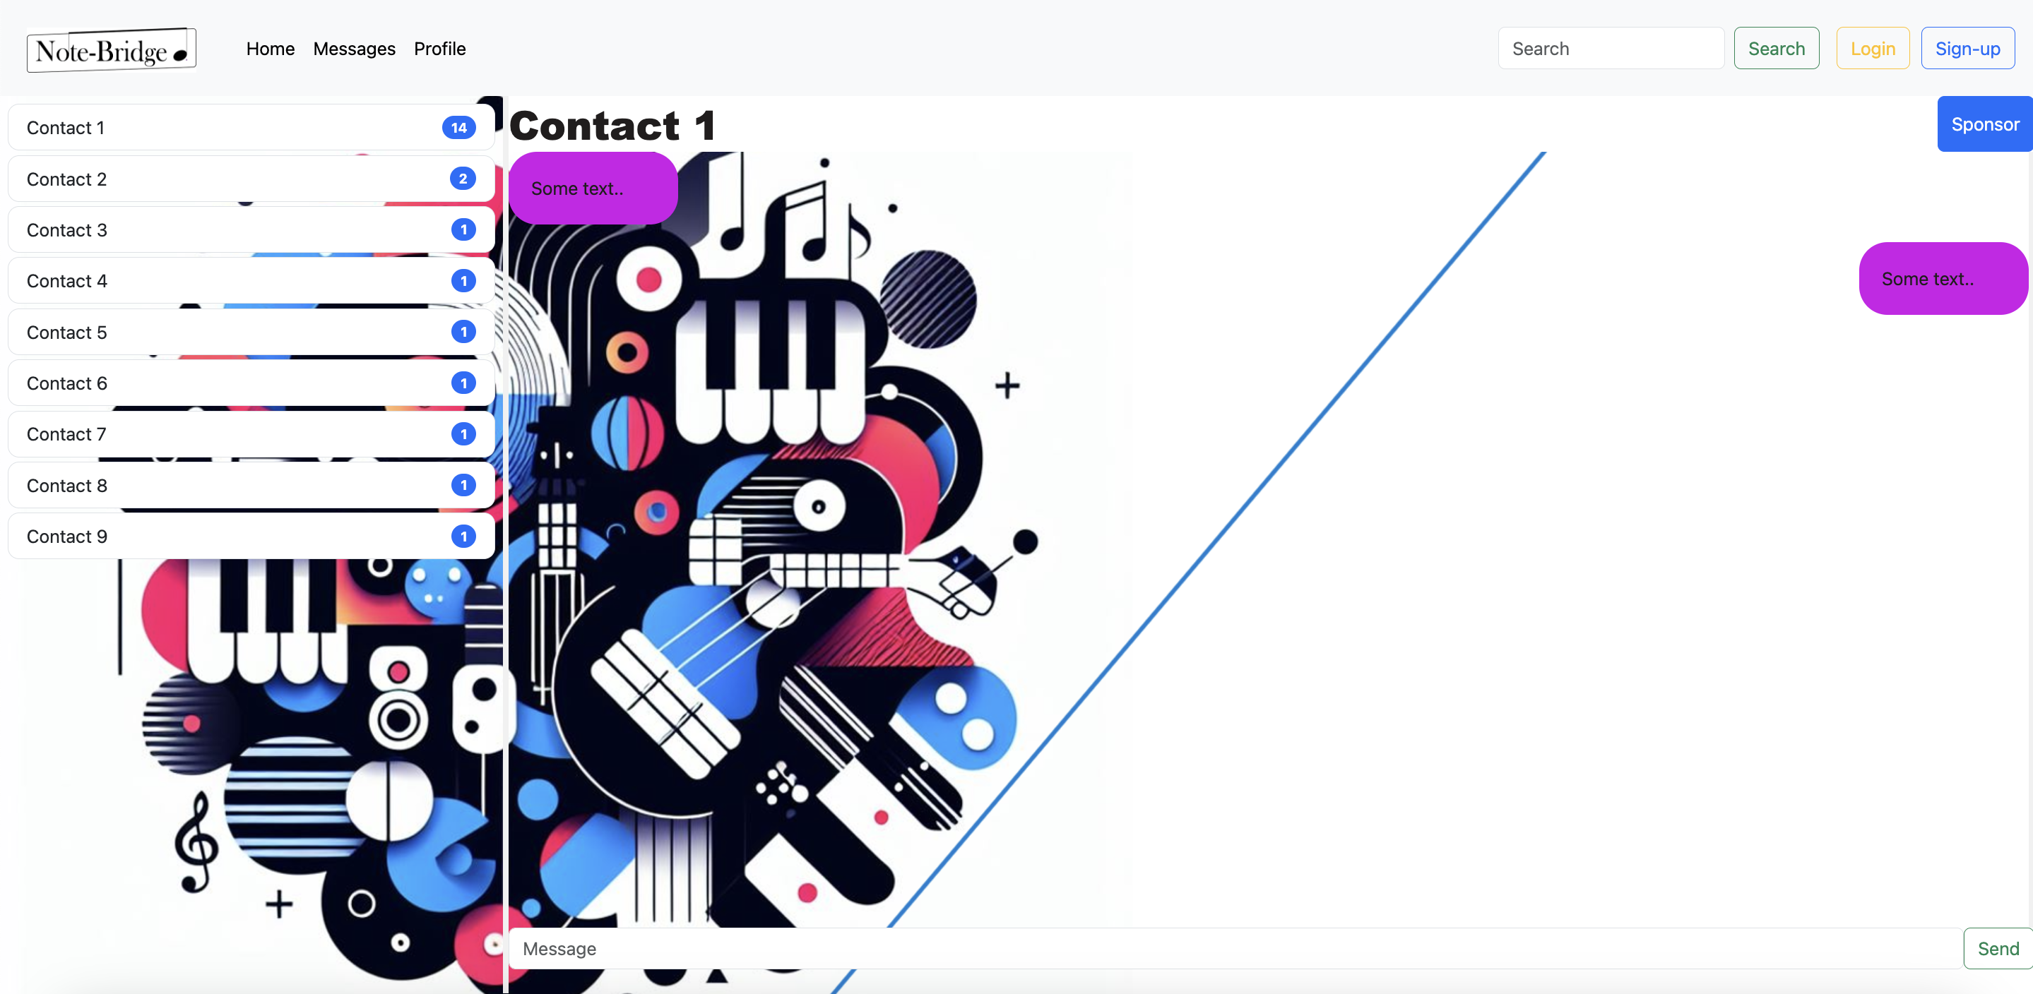
Messenger Page

Slide 13
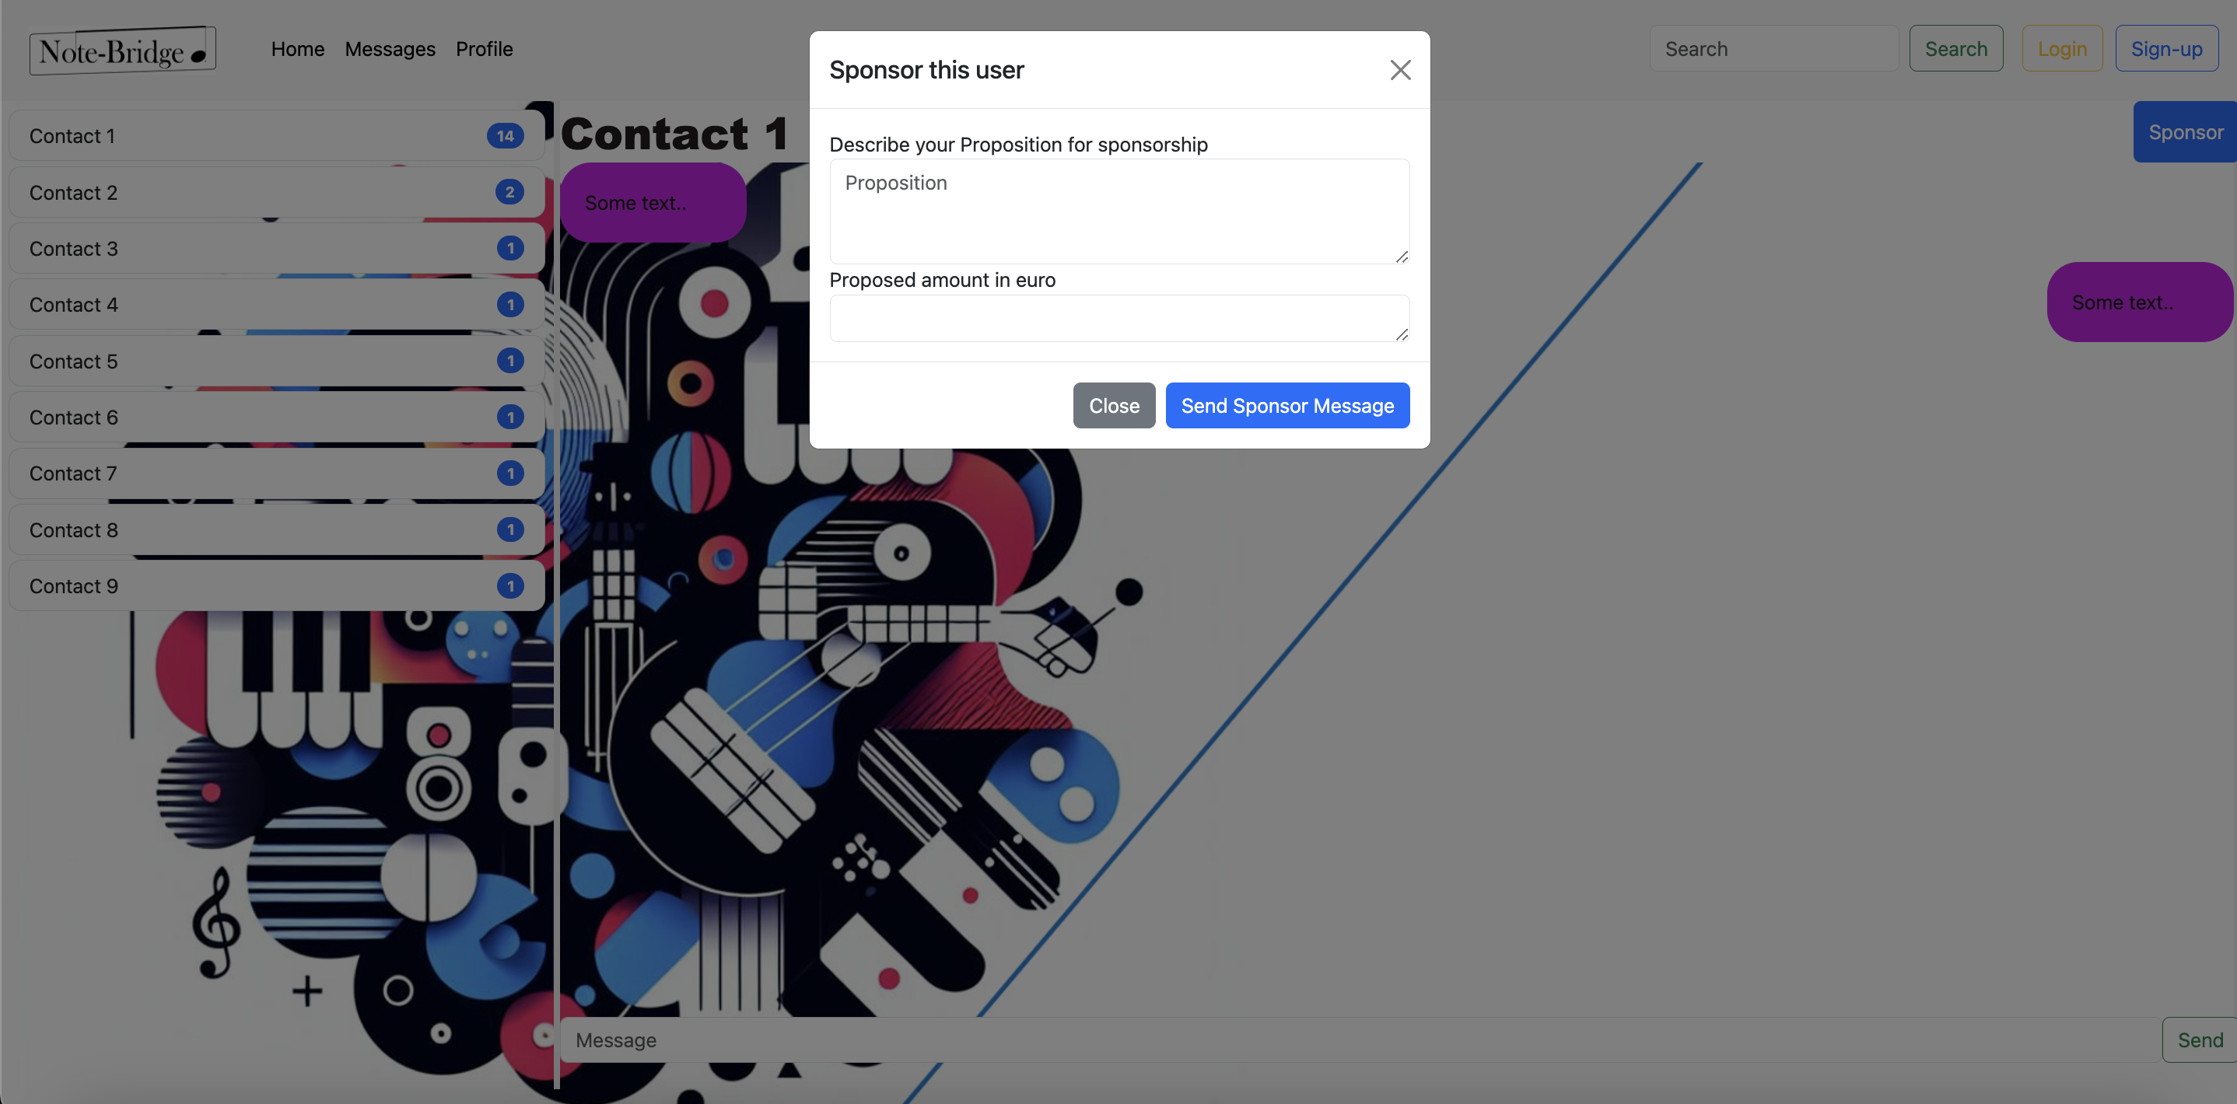
SPONSOR MODAL

Slide 14
Now ıt ıs tıme for seeıng prototype ın actıon
Let's see our prototype ın actıon

Slide 15
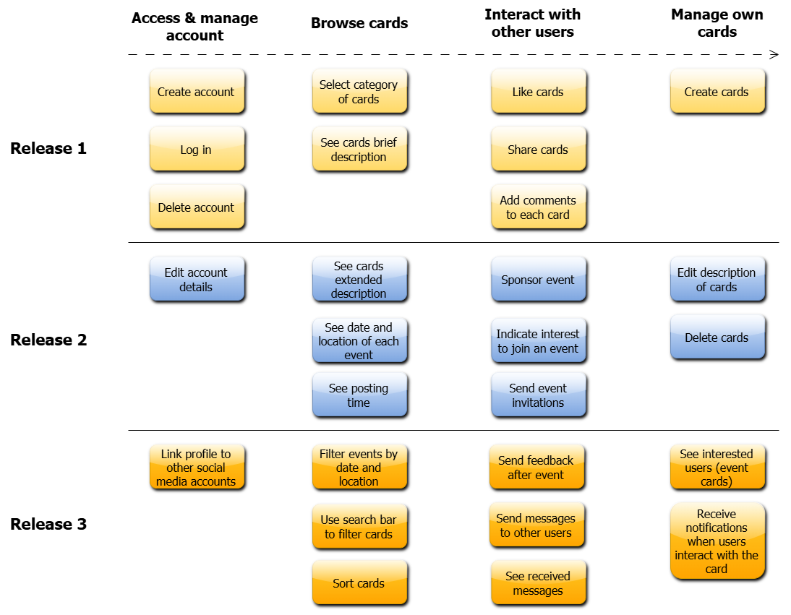
Story map

